Slide 1
Protracted Bacterial Bronchitis (PBB) The Bronchoscopy Findings
Prof. Mohammad Ashkan Moslehi, MD
Pediatrics Interventional Pulmonologist
(WABIP Pediatrics Section Chair)

Slide 2
What is PBB?
PBB (chronic bronchitis in childhood) has been officially recognized by the British Thoracic Society
PBB is a persistent or protracted bacterial infection of the respiratory airways
PBB is the common cause of chronic WET cough which lasts longer than four weeks among children worldwide

Slide 3
Protracted Bacterial Bronchitis
The three most commonly identified bacteria:
H influenzae, especially non-typable H. influenza strains
Streptococcus pneumoniae
Moraxella catarrhalis
The occurrence of PBB is related to:
bacterial biofilm formation in the airway
A biofilm is a matrix secreted by some bacteria that is thought to enhance attachment, facilitate access to nutrients and decrease antibiotic penetration
impaired mucociliary clearance
systemic immune function defects
airway anomalies and malacia

Slide 4
Protracted Bacterial Bronchitis
In PBB, it is often found that more than one organism is identified in bronchoalveolar lavage (BAL) samples
(even viruses ??rhinovirus, adenovirus, (RSV) and parainfluenza virus)

Slide 5
What are the Clinical Features of PBB?
Typically children with PBB are young - the majority of related studies involve children less than 6 years old.
Helpful questions:
Does he sound like a smoker first thing in the morning?
When did he have cough?
persistent cough
cough is typically worse when changing posture, just after lying down in bed and first thing in the morning

Slide 6
What are the Clinical Features of PBB?
Parents often describe their child becoming short of breath and coughing with exercise.
Gasping for breath
It is also common to report that a child has a 'wheeze‘? (ruttle)
A viral infection will exacerbate both asthma and PBB.
Introduction of a treatment such as an inhaled corticosteroid for a child with probable asthma or antibiotics for PBB is necessary to help confirm a presumptive diagnosis.

Slide 7
Protracted Bacterial Bronchitis
Children with PBB generally do not look unwell but agitated resulting from disturbed sleep
Parents often report that antibiotics have not helped but on closer questioning it may be that the cough was improving, with symptoms worsening quickly when the antibiotics were stopped.

Slide 8
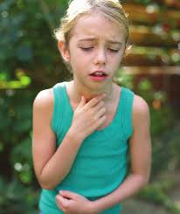
When and How to Diagnose PBB?
History
Physical examination
Chest Xray Normal?
May have only minor abnormalities such as peribronchial wall thickening
Hyperinflation is uncommon
Cough swabs can be useful but have a relatively low sensitivity
Basic immune function tests
Tuberculosis?
Pulmonary Function Tests

Slide 9
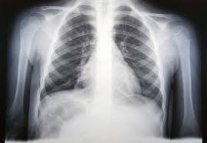
Protracted Bacterial Bronchitis
Chest radiograph

Slide 10
When and How to Diagnose PBB?
The definitive investigation
Flexible Bronchoscopy with BAL

Slide 11
When and How to Diagnose PBB?
Typically, we find secretions and edematous collapsible bronchi that collapse during suctioning while undertaking a BAL
Antibiotic usage often results in a negative culture, even in a child with significant symptoms
Positive cultures can be seen despite recent antibiotic use

Slide 12
BAL
Bacterial counts ≥104 colony-forming units (CFU)/ml +/- neutrophils >3.5% in BALF consider as positive result
The normal reference values for BAL: macrophages 80–95%, neutrophils <3.5%, lymphocytes <15%, eosinophils <1%

Slide 13
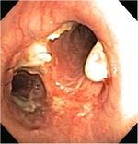
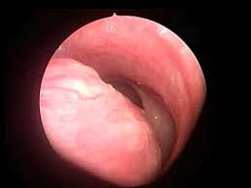
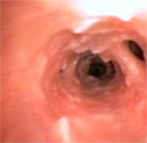
How is PBB Treated?

Slide 14
When and How to Diagnose PBB?
The original diagnostic criteria for PBB includes:
(a) wet cough >four weeks duration,
(b) identifiable lower airway bacterial infection on broncho-alveolar lavage (BAL) culture,
(c) response to antibiotics (amoxicillin/clavulanate) with resolution of cough within two weeks,
(d) the absence of an alternative specific etiology

Slide 15
Protracted Bacterial Bronchitis
If left untreated, PBB may develop into chronic suppurative lung disease (CSLD) in some children and possibly bronchiectasis
PBB is often misdiagnosed as bronchial asthma or bronchial pneumonia (more than 70% Vs 2% ), because pediatricians lack awareness of the disease.

Slide 16
Treatment
This is largely an evidence-free zone
Rx with Antibiotics is beneficial, with one clinical cure for every three children treated
The aim of treatment is to eradicate bacteria and to allow regeneration of the epithelium
Two weeks of high dose antibiotics such as co-amoxicillin/clavulanic acid will lead to resolution of the cough and a dramatic improvement in the child's quality of life, however recurrence of symptoms is described

Slide 17
Protracted Bacterial Bronchitis
The use of pneumococcal conjugate vaccines has not reduced the incidence of this condition
Physiotherapy to improve clearance
DNAse and osmotic agents may help restore mucociliary clearance
Asthma Rx

Slide 18
This presentation was prepared by
Prof. Mohammad Ashkan Moslehi and reviewed for accuracy and content by members of the WABIP Pediatric Section

