Slide 1
Primary Spontaneous Pneumothorax
Ankit Gupta MD, Kassem Harris MD

Slide 2
Primary Spontaneous Pneumothorax Background
Primary spontaneous pneumothorax (PSP) : Pneumothorax without any known underlying lung disease
Incidence : More common in men
18-28/100,000 cases/yr for men
1.2-6/1000,000 cases /yr for women
Age 15-34 years commonly
Recurrence rates for PSP: 17-54%
Technical Details, Challenges and Management of Complications
NEJM 2000;342:868
Am Rev Respir Dis 1987;29:1379-82
Thorax 2000;55:666-71

Slide 3
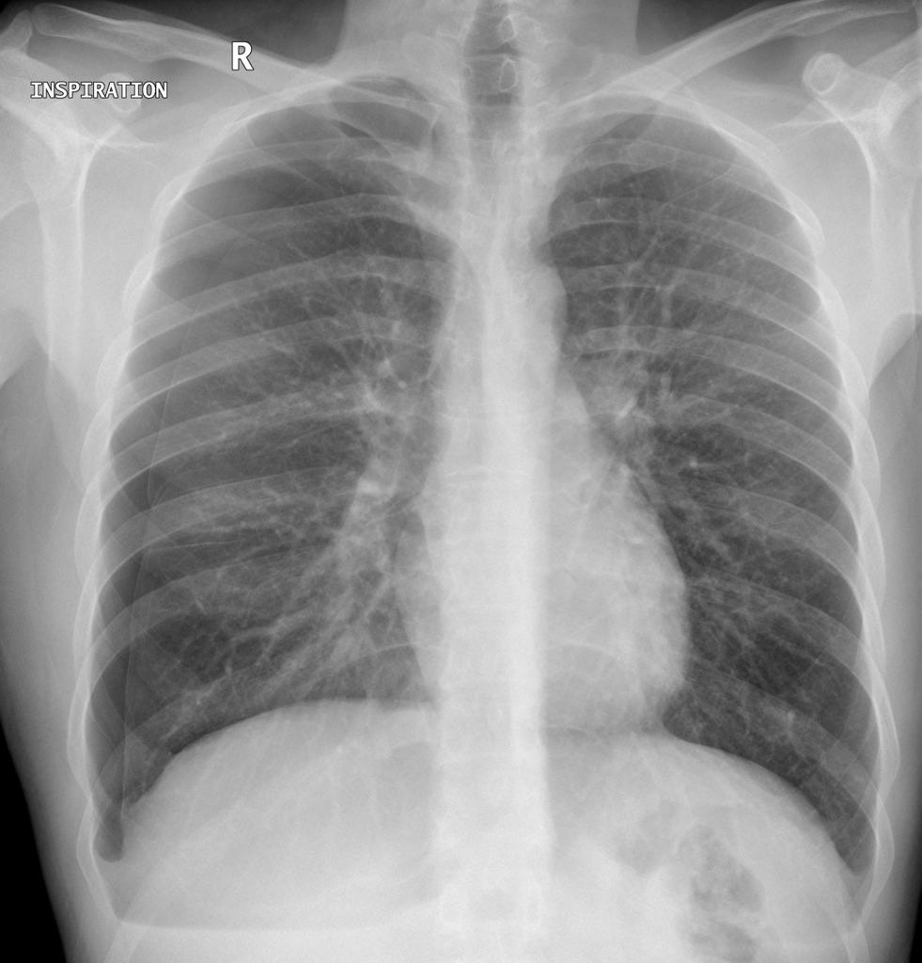
Primary Spontaneous Pneumothorax
Technical Details, Challenges and Management of Complications
Case courtesy of Dr Henry Knipe, Radiopaedia.org, rID: 27798

Slide 4
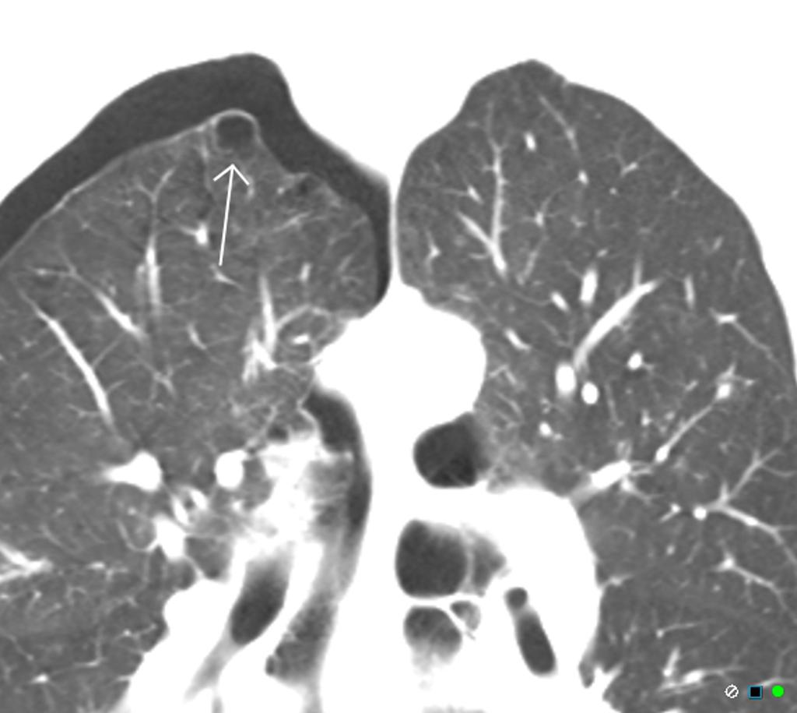
Primary Spontaneous Pneumothorax
Right apical bleb and
pneumothorax
Technical Details, Challenges and Management of Complications
Case courtesy of Dr Chris O'Donnell, Radiopaedia.org, rID: 19792

Slide 5
Primary Spontaneous Pneumothorax Pathogenesis
No totally clear
Rupture of apical subpleural blebs (< 1 cm in size)
Increase in pleural porosity secondary to inflammation. Auto-fluorescence has demonstrated pleural porosities in patients
Emphysema like changes(ELCs) may appear in small airways
Technical Details, Challenges and Management of Complications
Video assisted thoracoscopic surgery (VATS) showing blebs.
Respir Med Case Rep. 2016; 19: 109–111
Chest 1993;104:1767-9
AJRCC 2006;174:26-30
ERJ1995;8(Suppl 19):397
Respiration 2008;76(2):121-7.

Slide 6
Primary Spontaneous Pneumothorax Risk Factors
Cigarette smoking: >90% patients are smokers
Cannabis
Tall, thin males
Genetic :Birt-Hogg-Dubé syndrome, Marfan’s syndrome, homocystinuria
Technical Details, Challenges and Management of Complications
Chest 1987;92:1009
Eur J Carthiorac Surg 2017;52:679
Thorax 1997;52:805-9
AM J Med Genet 1991;40:155

Slide 7
Primary Spontaneous Pneumothorax Presentation
Often asymptomatic
Chest pain, shortness of breath
Tachypnea, use of accessory muscles
Tracheal shift might be visible: Trail sign
Hyper resonance on percussion
Auscultation: Diminished / no air entry on affected side
Tension pneumothorax from PSP is very rare
Tracheal Management of Complications
BMJ 1993;307:114-16

Slide 8
Primary Spontaneous Pneumothorax Diagnosis
Erect posteroanterior chest x-ray is the modality of choice:
White visceral pleural line
Pulmonary vessels are not visible beyond the pleural line
CT chest is usually not necessary but is helpful for:
Size estimation
Visualizing the parenchyma
Technical Details, Challenges and Management of Complications
Radiology 1989;173:707-11
Chest 1997;112:275-8

Slide 9
Primary Spontaneous Pneumothorax Ultrasound
Lack of lung sliding
Absence of normal comet tail or reverberation artifacts
Presence of Barcode/ Stratosphere Sign
Presence of a “lung point” or “transition point”
Technical Details, Challenges and Management of Complications
Crit Care 2006;10:R112

Slide 10
Primary Spontaneous Pneumothorax Ultrasound-Normal Lung
(a)The bat sign.’ Two ribs with posterior shadowing represents the wings of the bat, and the hyperechoic pleural line, its body
(b) A sagittal scan at the upper intercostal spaces depicting normal anatomy
Husain et al. J Emerg Trauma Shock. 2012 Jan-Mar; 5(1): 76–81.

Slide 11
Primary Spontaneous Pneumothorax Ultrasound-Normal Lung
‘B-lines’ or ‘comet-tail artifacts’ are seen originating from the bright white hyperechoic pleural line, extending vertically
to the edge of the screen. ‘B-lines’ move in synchrony with the sliding pleura in a normal well-aerated lung
M-mode illustrating the ‘seashore sign.’ The pleural line divides the image in half: The motionless portion above the pleural line creates horizontal ‘waves,’ and the sliding line below it creates granular pattern, the ‘sand’
Husain et al. J Emerg Trauma Shock. 2012 Jan-Mar; 5(1): 76–81.

Slide 12
Primary Spontaneous Pneumothorax Ultrasound-Pneumothorax
M-mode and the absence of lung sliding are shown as the ‘stratosphere sign’: Parallel horizontal lines above and below the pleural line, resemble a ‘barcode.’ This sign indicates a pneumothorax at this intercoastal space
‘A-lines’, a type of reverberation artifact, are horizontal, equally spaced lines seen originating from the bright white
hyperechoic pleural line. If ‘B-lines’ are present, they extend out from the pleural line and erase the ‘A-lines’ in their path
Husain et al. J Emerg Trauma Shock. 2012 Jan-Mar; 5(1): 76–81.

Slide 13
Primary Spontaneous Pneumothorax Ultrasound
‘Lung point sign.’ (Right) B-mode depicting the lung point: Sliding lung touching the chest wall. (Left) The ‘seashore sign’ (white arrow) and the ‘stratosphere sign’ (dotted arrow) as the lung intermittently contacts the chest wall
Husain et al. J Emerg Trauma Shock. 2012 Jan-Mar; 5(1): 76–81.

Slide 14
Primary Spontaneous Pneumothorax Ultrasound
‘Power slide’ in normal sliding lung. Power (angiography) Doppler is used at the pleural line, which is visualized lighting up with color flow as subtle sliding is detected. The probe must be steady to avoid unwanted color artifacts
Husain et al. J Emerg Trauma Shock. 2012 Jan-Mar; 5(1): 76–81.

Slide 15
Primary Spontaneous Pneumothorax Management
In the first episode of PSP, symptoms rather than pneumothorax size should determine further course
Asymptomatic patients can be safely observed
Needle aspiration(NA) alone can be the first line treatment in symptomatic first PSP
Persistent/ recurrent episodes require definitive management including pleurodesis or surgery
Technical Details, Challenges and Management of Complications
Eur Respir J. 2015 Aug;46(2):321-35

Slide 16
Primary Spontaneous Pneumothorax Management
Oxygen fastens pneumothorax resolution 3-4 times compared to room air
Theoretically, oxygen reduces the partial pressure of nitrogen in the alveolus compared with the pleural cavity, and a diffusion gradient for nitrogen accelerates resolution
Hyperoxemia especially in small pneumothoraces should be avoided
Technical Details, Challenges and Management of Complications
Respiration 1983;44:147-52
J Thorac Dis 2017 Dec;9(12):5239-5243

Slide 17
Primary Spontaneous Pneumothorax Management
British Thoracic Society guidelines suggest needle aspiration (NA) as an initial intervention in patients with a large or symptomatic primary pneumothorax.
The American College of Chest Physicians (ACCP) does not recommend needle aspiration for PSP
More recent data has suggested similar outcomes between needle aspiration and chest tube immediately, at 2 weeks and 1 year for first PSP
Eur Respir J.2017 Apr 12;49(4)
Thorax 2010;65:Suppl.2,ii18ii31
Chest 2001;119:590-602
Respir Med 2012;106:1600-05

Slide 18
Primary Spontaneous Pneumothorax Management
NEEDLE ASPIRATION
N Engl J Med 2013; 368:e24

Slide 19
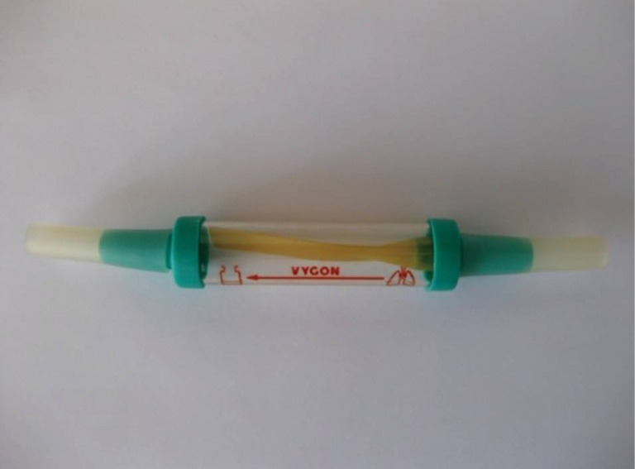
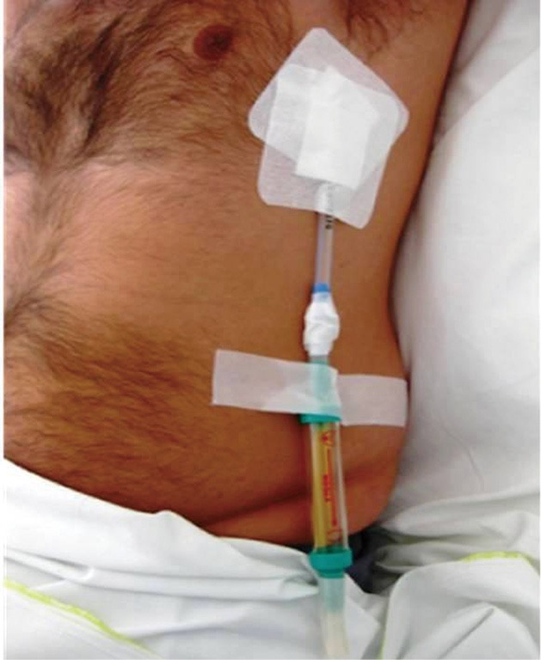
Primary Spontaneous Pneumothorax Management
Heimlich valve is a one way, rubber flutter valve that prevents
Evacuated air to re enter the thoracic cavity
Ann Trans Med 2015 Mar; 3(4): 54

Slide 20
Primary Spontaneous Pneumothorax Management
Small bore chest tubes/ pigtail catheters suffice and have similar
recurrence rates when compared to larger chest tubes
Compared to pigtail catheters, large-bore chest tubes are associated with higher complication rate with more infectious complications and significantly longer drainage duration
Technical Details, Challenges and Management of Complications
Chest.2018 Feb 13. pii: S0012-3692(18)30252-6
Respir Med. 2009;103(10):1436

Slide 21
Primary Spontaneous Pneumothorax Management
Chest tube can be attached to water seal until pneumothorax resolves
No role of suction in most cases unless an ongoing air leak and persistent pneumothorax on chest imaging
Once there is no more air leak and the lung has re expanded, chest tubes can be clamped and removed if chest X-ray is stable
Technical Details, Challenges and Management of Complications
Eur Respir J. 2015 Aug;46(2):321-35
Thorax 2010;65:Suppl.2,ii18-ii31

Slide 22
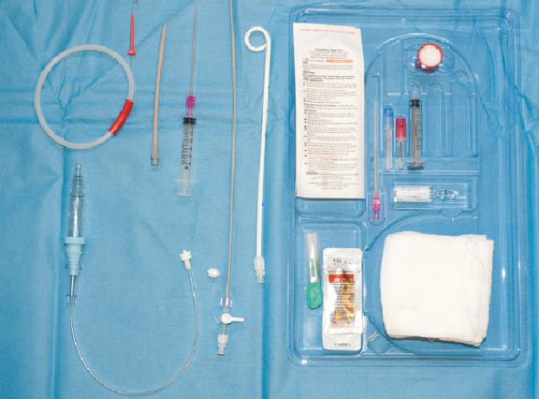
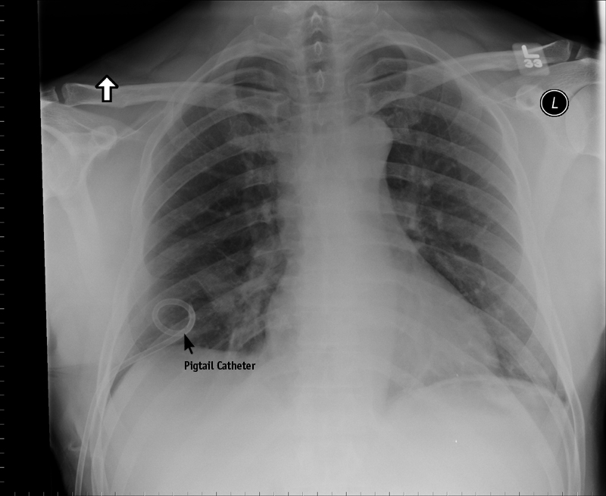
Primary Spontaneous Pneumothorax Management
PIGTAIL CATHETER

Slide 23
Primary Spontaneous Pneumothorax Management
There is a lack of data from randomized controlled trials regarding management of persistent or recurrent PSP. Recurrence rate reported :17-54%
Indications for definitive management:
Second episode of PSP
Persisting air leak >3–5 days
Hemopneumothorax(3-7% of PSP can be hemopneumothorax)
Bilateral pneumothorax(1 % of PSP can be bilateral)
Professions at risk (aircraft personnel, divers)
Eur Respir J. 2015 Aug;46(2):321-35
NEJM 2000;342:868
Lung India. 2017 May-Jun;34(3):283-286
J Vis Surg. 2017 Oct 27;3:146

Slide 24
Primary Spontaneous Pneumothorax Recurrence
Pleurodesis involves permanent apposition of the visceral and parietal pleura to seal the pleural space and can be :
Medical
Surgical
Current guidelines do not specify the optimal pleurodesis approach or agent for chemical pleurodesis
Technical Details, Challenges and Management of Complications
Thorax. 2017 Dec;72(12):1121-1131.

Slide 25
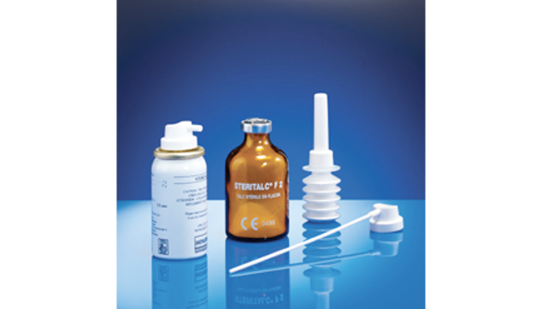
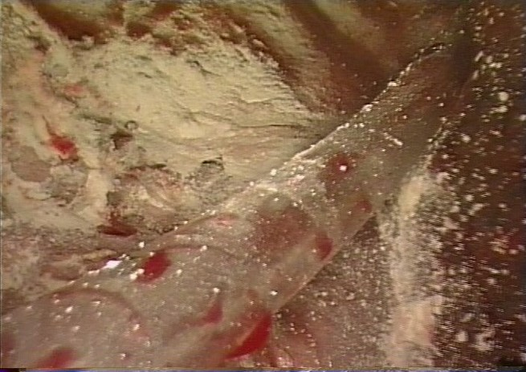
Primary Spontaneous Pneumothorax
TALC PLEURODESIS

Slide 26
Primary Spontaneous Pneumothorax ACCP/BTS
2001: The American College of Chest Physicians (ACCP) Delphi consensus statement recommends surgical pleurodesis (including bullectomy) for ongoing air leak or recurrence prevention at second occurrence.
British Thoracic Society in 2010 recommended surgical pleurodesis using open/video-assisted thoracoscopic surgery(VATS) compared to medical pleurodesis via Chemical agents due to less recurrences with the surgical approach but noted that direct comparative trials are lacking
No consensus on the utility of additional talc poudrage during the surgery
Chemical pleurodesis via a chest tube : Only for patients in whom surgery was contraindicated or patients who refused an operative procedure. Doxycycline or talc as the preferred agents.
Chest 2001;119:590-602
Thorax 2010;65:Suppl.2,ii18-ii31

Slide 27
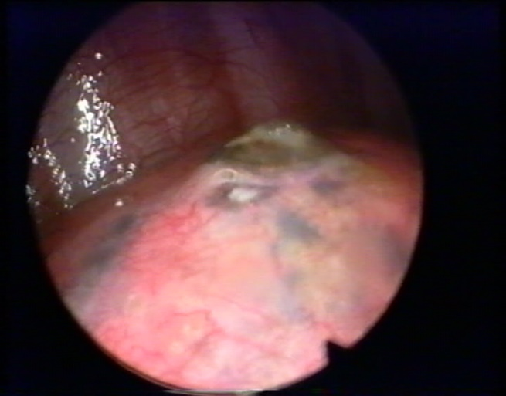
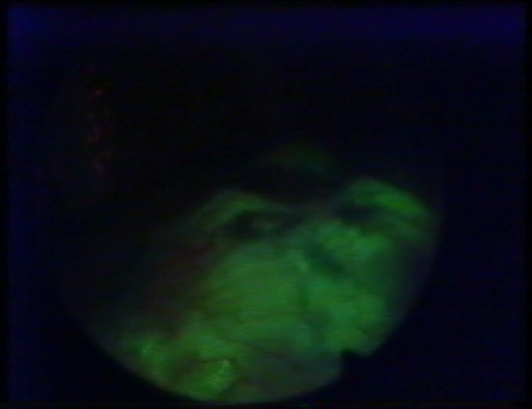
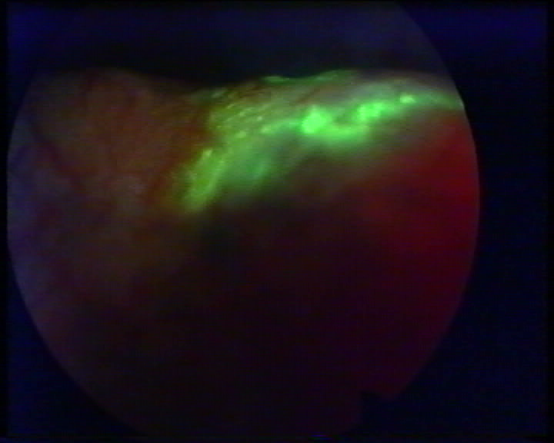
Fluorescein-enhanced Autofluorescence Thoracoscopy
Normal light thoracoscopy, the abnormal area is
about 2 x 2 cm
On autofluroscence, area is 7 by 6 cm, 10 times bigger
Abnormal area where there can be a leak is much bigger than what you see with thoracoscopy or surgically
Noppen M. Am J Respir Crit Care Med. 2004 Sep 15;170(6):680-2

Slide 28
Primary Spontaneous Pneumothorax Recurrence rates after definitive treatment of PSP
Study Yr | Procedure | n | Follow up months | Recurrence | Complications
2015(1) | Talc poudrage via Chest tube | 21 | 24 | 9.5% | None
2005(2) | Tetracycline via chest tube | 138 | 36 | 16%(yr 1) 27%(yr 3) | None
2013(3) | Minocycline via chest tube | 214 | 12 | 29.2% | None
2003(4) | Videothoracoscopic bleb excision and pleural abrasion | 167 | 93 | 3% | 27.4%( air leak, pneumonia),0 deaths
2010(5) | VATS bullectomy and talc poudrage | 124 | 12 | 0 | 5.6%
2008(6) | Open thoracotomy | 82 | 6 | 0 | 19.3%
Technical Details, Challenges and Management of Complications
1. J Bronchology Interv Pulmonol 2015;22:48–51 4. Ann Thorac Surg 2003;75:960-65
2. Respirology 2005;10:378–84 5. J Thorac Cardiovasc Surg 2010;140:1272–5
3. Lancet 2013;381:1277–82 6. Ann Thorac Med. 2008 Jan;3(1):9-12.

Slide 29
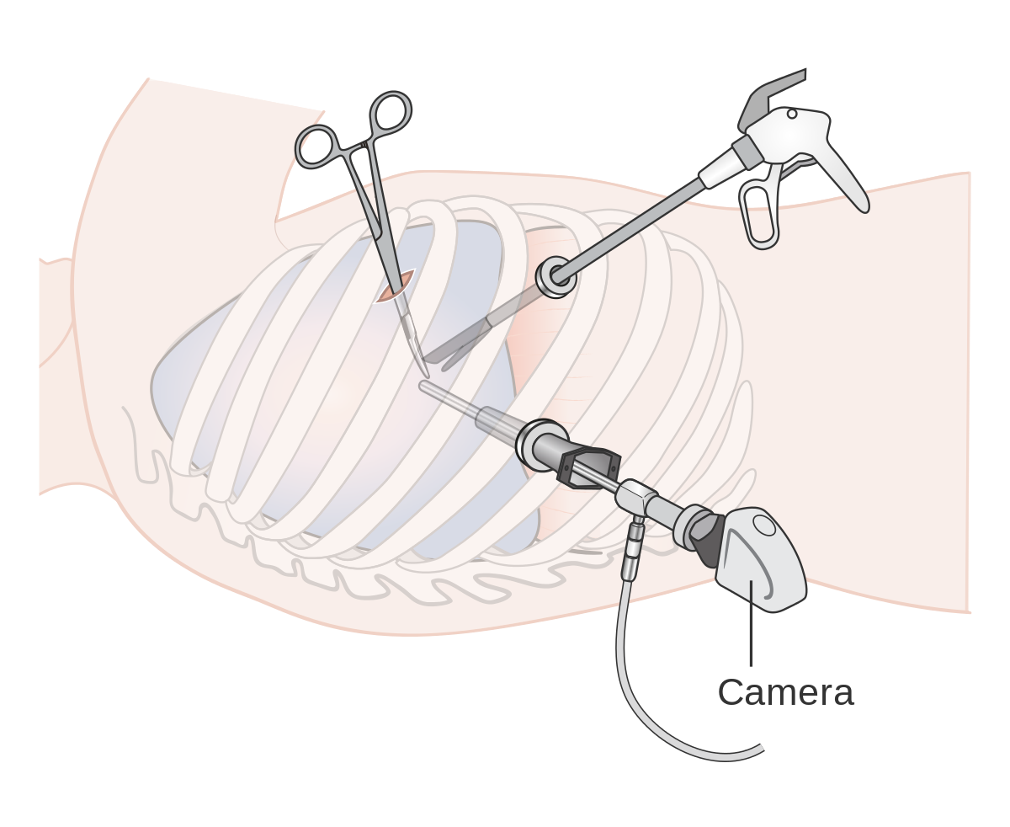
Primary Spontaneous Pneumothorax VATS

Slide 30
Primary Spontaneous Pneumothorax Knowledge Assessment
Question 1:
A 26 year-old male presented to the emergency department with right sided chest pain that started suddenly 2 hours ago. The patient does not have any other symptoms. His pulse oximetry indicated 100% on room air. His vital signs were: heart rate: 80 per minute, respiratory rate: 18 per minute and blood pressure: 115/75. The patient never had lung disease and has no past medical history. He started smoking 8 years ago about half pack a day.
Physical examination including lung auscultation was normal.
A chest x-ray showed right apical pneumothorax that is 3 cm from the apex.
What is next step?

Slide 31
Primary Spontaneous Pneumothorax Knowledge Assessment
Answer for question 1:
Because the patient is symptomatic, the next would be to perform needle aspiration of the right pneumothorax. Ultrasound of the chest may help in choosing the site of pneumothorax to place the needle. The patient may be observed for 6 hours with repeat imaging to evaluate for recurrence.
Another option is to place a small bore chest tube for drainage.

Slide 32
Question 2:
The patient underwent pneumothorax aspiration and was discharged home after a repeat chest x-ray showing no recurrence. Three days later, he presented to the emergency department with right chest pain similar to the prior episode. He is also complaining of dyspnea and cough. His pulse oximetry was 95% on room air. His vitals were: heart rate: 130 per min, respiratory rate of 30 per min and blood pressure of 100/65.
An ultrasound of the chest was immediately performed and showed the absence of sliding sign, presence of A-line. Using the M mode, the stratosphere sign was shown.
An 8 French pigtail catheter was immediately placed which resulted in quick resolution of the patient’s symptoms.
After admitting the patient to a regular hospital bed, what would be the next step?

Slide 33
Answer for questions 2:
Because this is the second episode of primary spontaneous pneumothorax, a thoracic surgery consult for video-assisted thoracoscopic surgery to manage the recurrent pneumothorax should be made. During the procedure, the surgeon may perform bullectomy with or without talc poudrage for pleurodesis.

Slide 34
This presentation was prepared by
Authors:
Ankit Gupta MD, Hartford Healthcare , Norwich Connecticut
Kassem Harris MD, Westchester Medical Center, Valhalla NY
and reviewed for accuracy and content by members of the
WABIP Rare Lung, Pleura and Airway Disorders section

