Slide 1
Rare Airway Tumors - Benign
Marwan Saoud MD,
Kassem Harris MD, FCCP
Co-Chair: WABIP Rare Lung, Pleura & Airway Disorders

Slide 2
Rare Airway Tumors (RATs) Cell Type
Mesenchymal Cell
Salivary Gland
Epithelial Cell
Miscellaneous

Slide 3
Mesenchymal Cell RATs
Benign
Lipoma
Schwannoma
Leiomyoma
Hemangioma
Hamartoma
Chondroma
Glomus Tumor
Granular Cell Tumor

Slide 4
Salivary Gland RATs
Benign
Mucus Gland Adenoma
Oncocytoma

Slide 5
Epithelial Cell RATs
Benign
Papilloma

Slide 6
Miscellaneous RATs
Benign
Inflammatory Myofibroblastic Tumor
Extramedullary Plasmacytoma

Slide 7
Lipoma
Benign mesenchymal cell tumor
Prevalent in adults age 50-60 years old, males>females
Associated with smoking and obesity
Appears as a hilar shadow or atelectasis on x-ray
Appears as a soft, pale, glistening, poorly vascular mass on bronchoscopy
Definitive diagnosis via biopsy which is difficult due to firm, fibrous sheath around the tumor
Treatment options include :
1. Bronchoscopic resection
2. Surgical resection if there is atypical features
3. Lobectomy or pneumonectomy if there is parenchymal involvement
BMC Pulm Med 2009; 9: 40
Pathol Int 2011; 61(4): 252-8

Slide 8
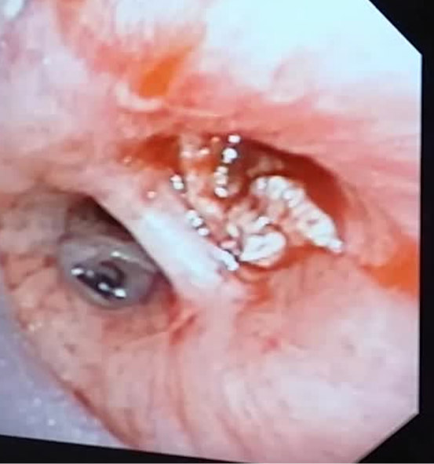
Lipoma
Endobronchial lipoma originating from the superior segment of the right lower lobe
Post mechanical debulking of the endobronchial lipoma

Slide 9
Schwannoma
Benign mesenchymal cell tumor
51 cases reported in the literature with Male:Female ratio of 2:3
Appears as heterogenous spherical lesions on CT or MRI
Appears as a smooth, round, white, non-vascular mass on bronchoscopy
Definitive diagnosis via biopsy as confirmed by the presence of bipolar and spindle cells within a myxoid matrix
Tissue stains positive for S-100
Treatment options include:
Surgical resection
Endoscopic excision for more localized tumors and/or poor pulmonary function
J Bronchol Intervent Pulmonol 2012; 19: 75-77

Slide 10
Leiomyoma
Benign mesenchymal cell tumor
Prevalent in adults with mean of age 35-40 years, males>females
Can be detected on x-ray and CT scans
Appears as a smooth, pink, polypoid mass with smooth contours and broad base on bronchoscopy
Biopsy is the definitive diagnosis
Histology consistent with pseudostratified columnar epithelium with spindle-shaped cells and acidophilic cytoplasm
Tissue stains positive for caldesmon and desmin
Treatment options include:
Surgical resection via carinal resection, tracheal sleeve resection, or segmental tracheal resection
Bronchoscopic resection
Eur J Cardiothorac Surg 2012; 41(1): 41-5
Lung India 2013; 30(1): 57-60

Slide 11
Hemangioma
Benign mesenchymal cell tumor
10 reported cases in infants
Rarely captured on plain radiological imaging techniques
Appears as a vascular/hemorrhagic polypoid lesion on bronchoscopy
Biopsy is the definitive diagnosis
Histology consistent with lobular capillary hemangioma
Treatment options include:
Bronchoscopic resection
Bronchial artery emobilization by IR
Medical therapy with high-dose corticosteroids in children
Heart Lung Circ 2013; 22(12): 1030-2

Slide 12
Hemangioma
Left Main Stem Hemangioma

Slide 13
Hemartoma
Benign mesenchymal cell tumor
43 cases reported in adults with mean age of 62 years
Male:Female ratio of approximately 6:1
Resembles fatty or calcified lesions on CT scan
Appears as a smooth, round, pink, non-vascular lesion on bronchoscopy
Biopsy is the definitive diagnosis
Collection of fat, cartilage, fibrous tissue and epithelial cells are seen on histological analysis
Treatment options include:
Bronchoscopic resection
Surgical resection
Tuberc Respir Dis (Seoul) 2014; 76(3): 141-5

Slide 14
Chondroma
Benign mesenchymal cell tumor
Prevalent in adults with mean age of 46 years
Male:Famale ratio of 3:2
Appears as a lobar consolidation on x-ray and pedunculated, vascularized lesion on bronchoscopy
Biopsy is the definitive diagnosis and tissue analysis consistent with characteristic chondromatous tissue
Bronchoscopic excision is the treatment of choice
Respir Care 2014; 59(12): e193-6

Slide 15
Glomus Tumor
Benign mesenchymal cell tumor
31 cases reported, mean age of 52 years
Male:Female ratio of 2:1
Characterized by marked contrast enhancement on CT scan
Appears as a vascularized, hyperemic mass with solid surface on bronchoscopy
Biopsy is the definitive diagnosis and reveals sheets of cells around the capillaries in an eiosinophilic cytoplasm
Tissue stains positive for vimentin and smooth muscle actin
Treatment options include:
Sleeve resection with primary reconstruction of the trachea
Bronchoscopic resection for intra-luminal tumors
Respir Care 2011; 56(3): 342-6

Slide 16
Granular Cell Tumor
Benign mesenchymal cell tumor
31 cases have been reported in adults
Can be detected on x-ray or CT scan
Appears as pedunculated polypoid lesions on bronchoscopy
Biopsy is the definitive diagnosis and tissue stains positive for S-100
Surgical resection is the preferred treatment modality
Am J Respir Crit Care Med 2013; 187: A6136

Slide 17
Mucous Gland Adenoma
Benign salivary gland tumor
More common in females than males
Not easily detectable on x-ray or CT scans
Appears as solitary, polypoid nodules on bronchoscopy
Biopsy is the definitive diagnosis and tissue analysis reveals cystic mucus-filled glands
Treatment options include:
Bronchoscopic resection
Surgical resection
Radiographics 2009; 29(1): 55-71

Slide 18
Oncocytoma
Benign salivary gland tumor
10 cases reported, males>females
Associated with tobacco smoking
Not easily detected on x-ray or CT scans
Appears as polypoid nodules on bronchoscopy
Biopsy is the definitive diagnosis and tissue analysis reveals polygonal cells forming sheets, trabeculae and acinar structures
Treatment options include:
Surgical resection
Bronchoscopic resection
Radiographics 2009; 29(1): 55-71

Slide 19
Papilloma
Benign epithelial cell tumor
50 cases reported, mean age of 54-68 years, males>females
Association with Human Papilloma Virus (HPV)
Focal bronchiectasis is commonly seen on x-ray
Appears as polypoid or pudunculated, glistening, non-vascular lesions with tan to red color on bronchoscopy
Biopsy is the definitive diagnosis
3 cell subtypes: squamous, glandular and mixed
Characteristic histological feature is intracellular mucin
Tissue stains positive for MUC5AC which is expressed in goblet cells
Bronschoscopic resection is treatment modality of choice
Cytojournal 2011; 8: 6

Slide 20
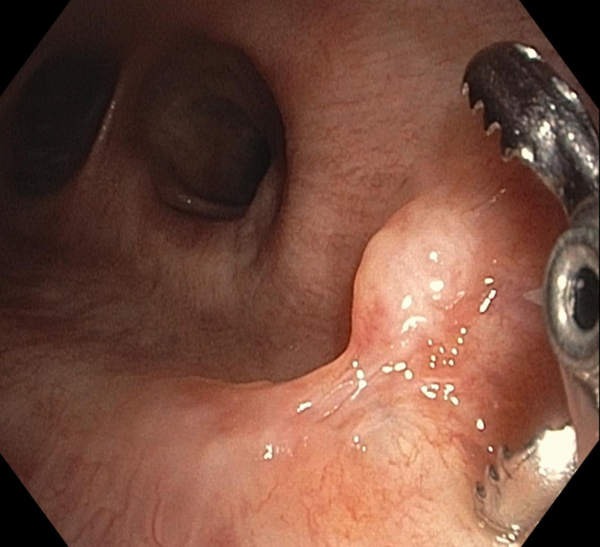
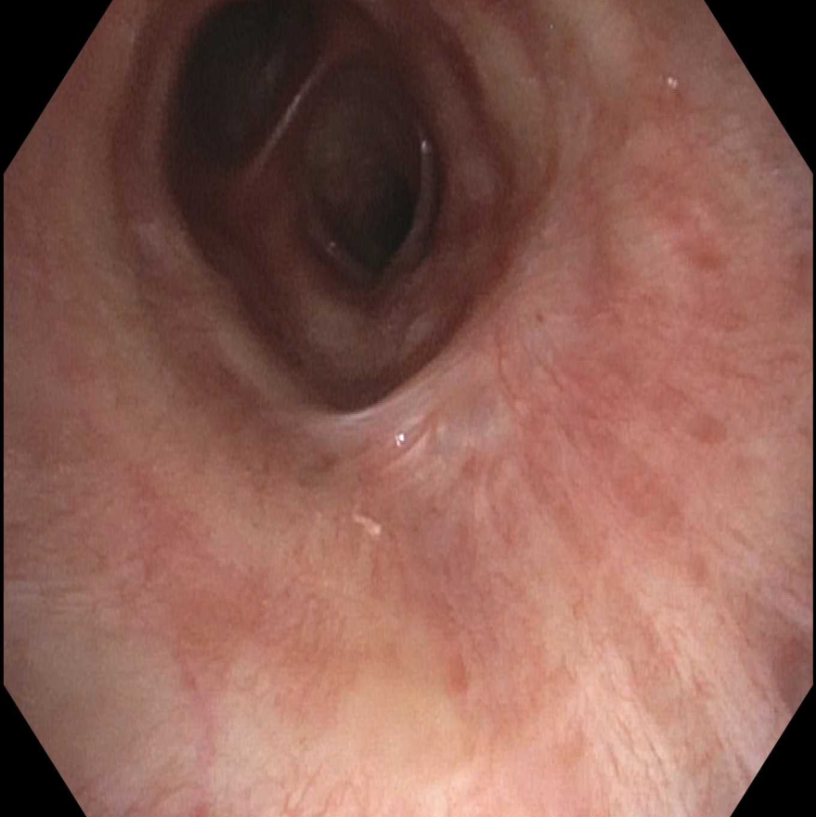
Papilloma
Papilloma of the bronchus intermedius
Bronchoscopic image 6 months after ablation using argon plasma coagulation showing minimal scarring and no recurrence of the papilloma

Slide 21
Inflammatory Myofibroblastic Tumor
Benign miscellaneous tumor
Rare tumor reported in young population (<16 years of age)
Non-specific lesions on x-ray and CT scan
Appears as a vascular, smooth lobulated mass on bronchoscopy
Biopsy is the definitive diagnosis
Histology consistent with myofibroblastic spindle cells, inflammatory plasma cells, lymphocytes and eosinophils
Tissue stains positive for vimentin, muscle-specific actin, SMA and ALK-1
Treatment options inlcude:
Surgical resection
Bronchoscopic resection
Medical therapy with NSAIDs, steroids and ALK-inhibitors
Respirology Case Reports 2014; 2(4): 147-149
J Thorac Dis 2011; 3: 255-261
J Thorac Oncol. 2015 Sep;10(9):e89-90

Slide 22
Inflammatory Myofibroblastic Tumor
Microscopic image of inflammatory myofibroblastic tumor. The image shows bland spindle cells without necrosis or mitoses, fibromyxoid stroma and scattered plasma cells (blue arrow). Hematoxylin and Eosin stain.

Slide 23
Extramedullary Plasmacytoma
Benign miscellaneous tumor
5 cases reported, mean age of 56 years, male:female ratio of 4:1
Appears as a smooth-surface mass on bronchoscopy
Biopsy is the definitive diagnosis with 5 criteria:
Single extramedullary mass of clonal plasma cells
Histologically normal bone marrow
Lack or decrease in serum or urinary level of monoclonal immunoglobulin
Absence of anemia
Normal skeletal survey
Characterisitic histological feature is the kappa chain-type and lambda chain-type cells
Treatment options include:
1. Argon plasma coagulation via rigid bronchoscopy for narrow-base tumors
2. Surgical resection followed by radiotherapy for wide-base tumors
Mass. Internal Medicine 2013; 52: 2113-2116

Slide 24
Outcomes
RATs prognosis depend on multiple factors:
Tumor malignant potential
Tumor location
Patient’s co-morbidities
Risks of treatment modality
Benign tumors are usually localized and amendable to resection with no or minimal risk of recurrence
Outcome of malignant tumors depend mainly on lymph node and adjacent tissue metastasis
Tumors found on the carina have poor prognosis due to the high risk of surgical resection attributed to the anatomical feasibility
Lancet Oncol 2006; 7(1): 83-91
Intern Med 2013; 52(18): 2113-6

Slide 25
This presentation was prepared by
Marwan Saoud MD and Kassem Harris MD, FCCP
and reviewed for accuracy and content by members of the
WABIP Rare Lung, Pleura and Airway Disorders section

